Slide 1


Acoustic scene classification
Cognitive Computing and Artificial Intelligence 2024
University of Catania, Italy
2023-2024

Slide 2
Team
• Aldo Barca 1000050457
• Francesco Cerruto 1000005927
•Giovanni Traina
1000053629

Slide 3
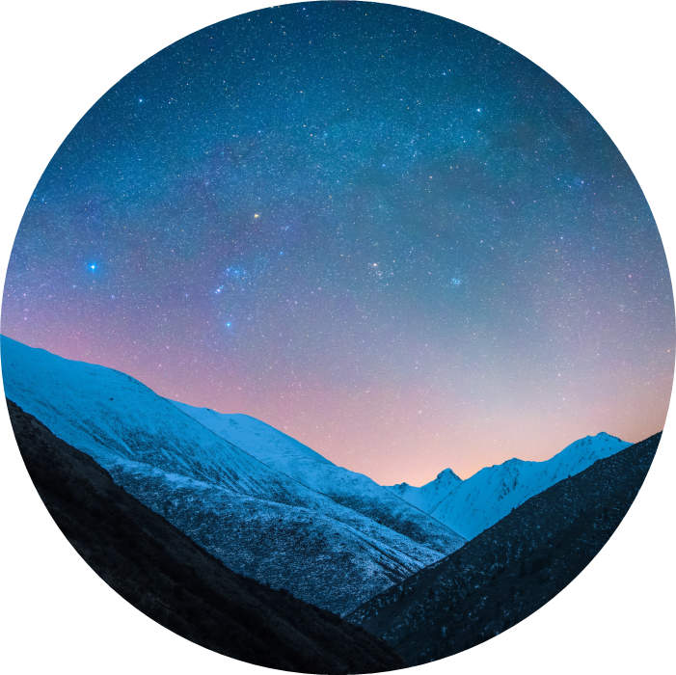
Introduction
Acoustic scene classification is an important task based on recognizing given an audio, in which type of environment the audio was taken of. The difficulty of the task is based on the noisy environment and the variability of sounds which every environment can have.
Moreover, gathering lots of data is really hard, considering the privacy laws, so it’s really hard to have huge datasets.

Slide 4
Task specification
The key points of the project are:
Train a network using fine-tuning
Use TUT 17 Dataset
Perform training 3 times, varying the portion of usable data of the dataset(100%,50% and 10%)
Test the network created and try to get good results

Slide 5
Our key ideas
We choose to use Audio Spectrogram Transformer(AST) pre-trained on AudioSet. AST can be easily synthetized as the equivalent of ViT(seen at lesson) for Audio instead of Images. As a transformer, a state of art architecture, it can grant great performances. In particular when there is temporal ( in an audio scenario) correlation or sequential correlation( in a speech scenario). This particularity is thanks to its core difference from other architectures, the attention.

Slide 6
TUT 17
The dataset used by our model is TUT 17. It’s composed by 4680 audio of 15 different acoustic scenes. Every audio is exactly 10s and so there is no different duration audio problem ( really dangerous for Audio Processing Models).
The dataset has labels divided in 8 files, already divided in 4-folds. For each fold there is a file called foldn_train.txt and foldn_evaluate.txt. Each file contains in a csv format the audio name and the corrispective true acoustic scene of the audio (label).
The fold-divided structure of the dataset is made to make 4-folds cross-validation easy to do with an already fold-divided structure of the 4680 audio. The dataset founder decided to use a 0.666 fraction of the audios for the train and the remaining 0.333 for the evaluation(test), for a total of 3510 audios for training and 1170 for testing.

Slide 7
The model
AST, acronym of Audio Spectrogram Transformer, as the name suggest is a Transformer type model based on spectrogram inputs. Therefore it’s literally made for audio processing.
In our case we are taking the AST pre-trained model using the ASTModel class from the transformers library. The ASTModel class return us an AST pre-made model without the classification head (fully connected/ linear layer).
This allow us to fine tune the already pre-trained model on our task-specific dataset, creating and adding to the model a perfectly suitable task-oriented classifier head.

Slide 8
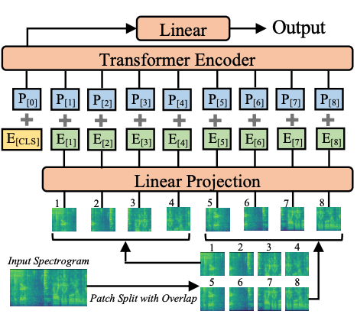
Given the spectrogram input, firstly Ast does a positional encoding of the spectrograms, so that it knows the position of the various features in the spectrogram
Then the inputs are given to a linear projection layer where features extracted from the spectrogram are turned into a lower dimensional space without loosing meaningful informations
Lastly the encoder, key component of a Trasformer model thanks to the attention mechanism captures the different relationships between various part of the spectrogram
AST Architecture

Slide 9
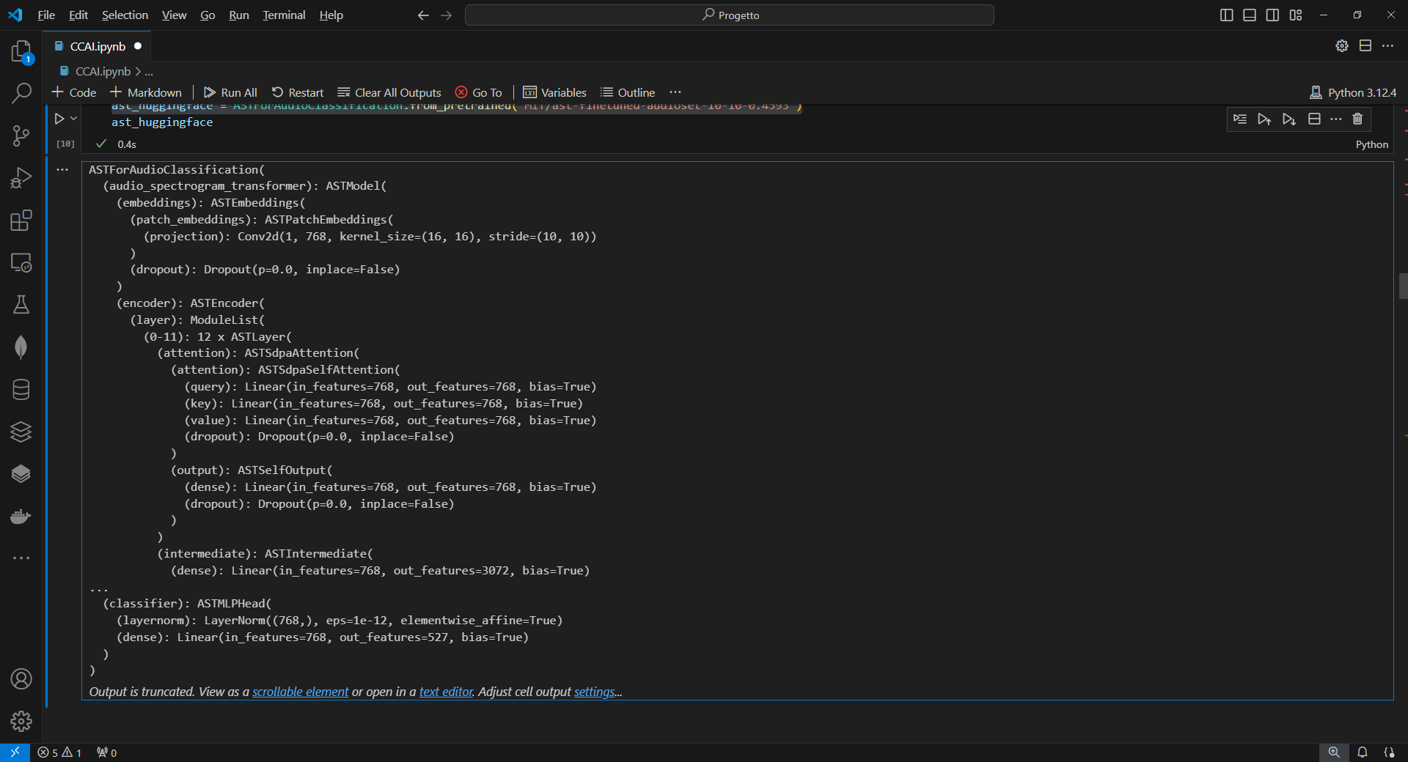
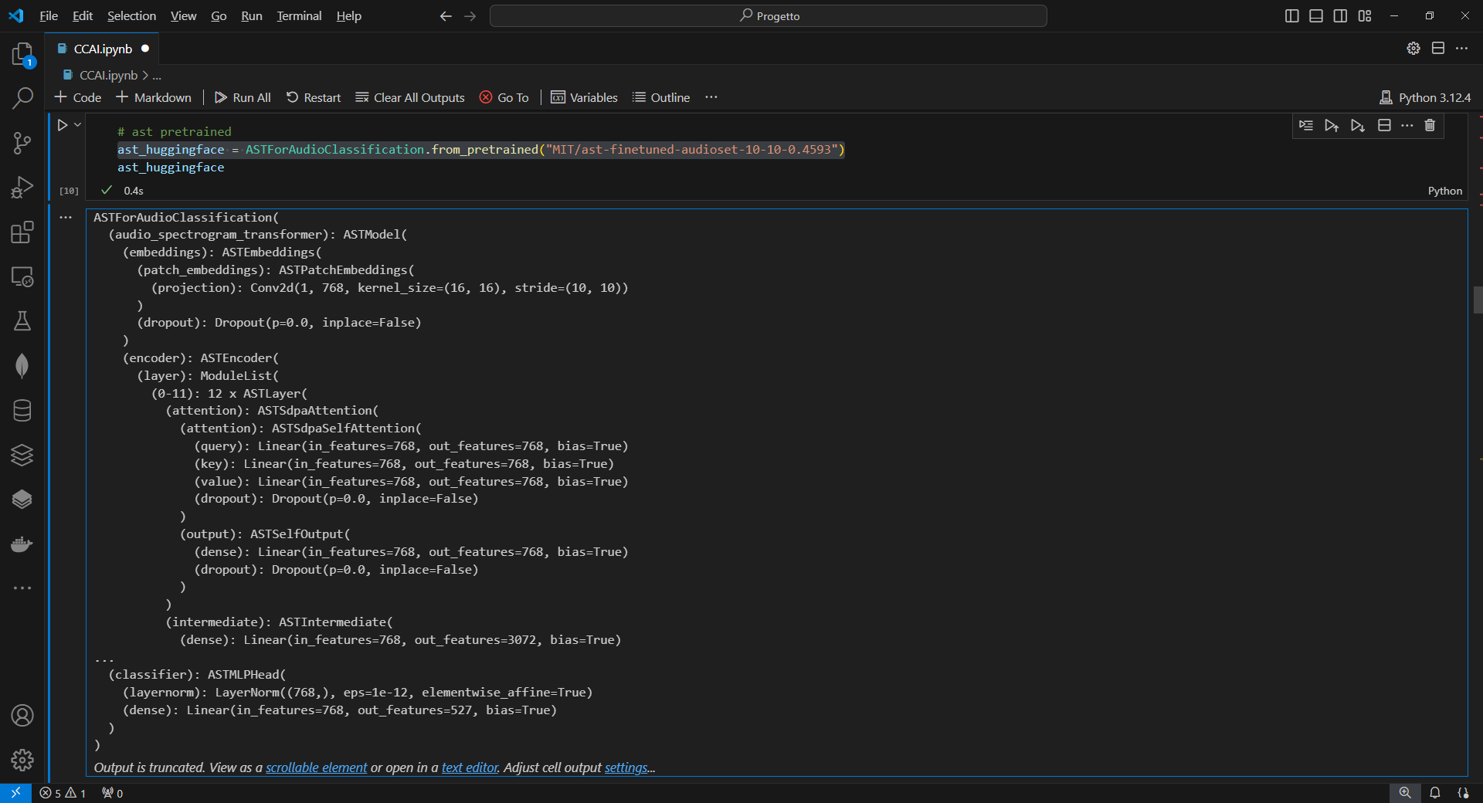
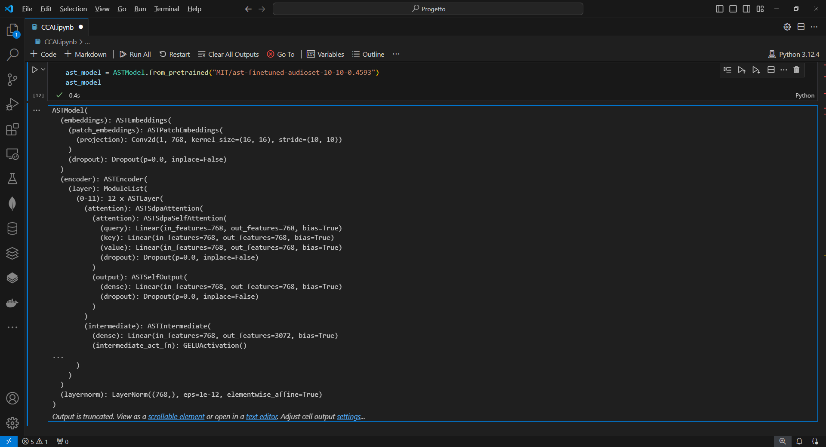
feature_extractor = AutoFeatureExtractor.from_pretrained("MIT/ast-finetuned-audioset-10-10-0.4593")
ast_huggingface = ASTForAudioClassification.from_pretrained("MIT/ast-finetuned-audioset-10-10-0.4593")
Notes:
Note: Si usa la GeLu, Gaussian Error Linear Unit come Funzione di attivazione in alcuni layer dell’encoder, rispetto alla classica ReLu la GeLu evita meglio l’overfitting e lavora meglio con valori negativi dei neuroni.

Slide 10
Our key ideas
We choose to use Audio Spectrogram Transformer(AST) pre-trained on AudioSet. AST can be easily synthetized as the equivalent of ViT(seen at lesson) for Audio instead of Images. As a transformer, a state of art architecture, it can grant great performances. In particular when there is temporal ( in an audio scenario) correlation or sequential correlation( in a speech scenario). This particularity is thanks to the core difference from other architectures, the attention.
Considering the task as a supervised multi-classification problem, where each class is one of the possible acoustic scene(also referred as environments)

Slide 11
Chart

Slide 12
Table
 | Category 1 | Category 2 | Category 3 | Category 4
Item 1 | 4.5 | 2.3 | 1.7 | 5
Item 2 | 3.2 | 5.1 | 4.4 | 3
Item 3 | 2.1 | 1.7 | 2.5 | 2.8
Item 4 | 4.5 | 2.2 | 1.7 | 7

Slide 13

The way to get started is to quit talking and begin doing.
Walt Disney

Slide 14
Timeline
Title
To start a presentation, go to the Slide Show tab, and select From Beginning.
Title
To display Presenter view, in Slide Show view, on the control bar at the bottom left select the three dots, and then Show Presenter View.
Title
During your presentation, the speaker notes are visible on your monitor, but aren't visible to the audience.
Title
The Notes pane is a box that appears below each slide. Tap it to add notes.
Title
If you don’t see the Notes pane or it is completely minimized, click Notes on the task bar across the bottom of the PowerPoint window.

Slide 15
Title
Subtitle
Subtitle
Add text, images, art, and videos.
Add transitions, animations, and motion.
Save to OneDrive, to get to your presentations from your computer, tablet, or phone.
Open the Design Ideas pane for instant slide makeovers.
When we have design ideas, we’ll show them to you right there.

Slide 16
Title
Subtitle
Subtitle
Subtitle
Add text, images, art, and videos.
Add transitions, animations, and motion.
Save to OneDrive, to get to your presentations from your computer, tablet, or phone.
Open the Design Ideas pane for instant slide makeovers.
When we have design ideas, we’ll show them to you right there.
This PowerPoint theme uses its own unique set of colors, fonts, and effects to create the overall look and feel of these slides.
PowerPoint has tons of themes to give your presentation just the right personality.

Slide 17



Summary
With PowerPoint, you can create presentations and share your work with others, wherever they are. Type the text you want here to get started. You can also add images, art, and videos on this template. Save to OneDrive and access your presentations from your computer, tablet, or phone.

Slide 18



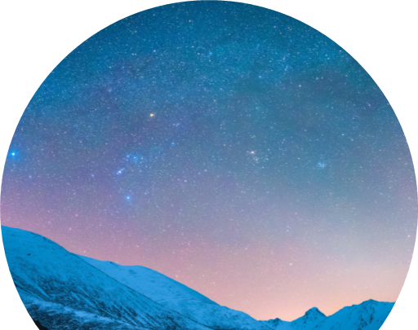
Thank you
Presenter name
Email address
Website

